Slide 1


STUBBLE AGGREGATION & ITS PROPER DISPOSAL
Theme – Waste Management
PSID – AN316
PSO -
Our Solution -

Slide 2
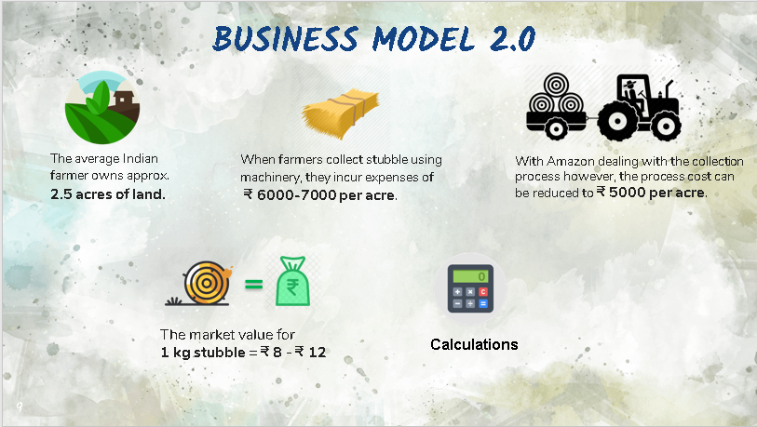


Slide 3
According to government agencies 2500 Kg- 3000 Kg of stubble is collected from 1 acre of land.
Min
Max
So the amount for 2500 Kg of stubble = Rs. 8 * 2500 = ₹ 20,000
Therefore, Profit per acre
= 20,000 – 5,000 = 15,000 ₹/acre
On an average profit from every piece of land = 15,000 * 2.5
= ₹ 37,500
So the amount for 3000 Kg of stubble = Rs.12 * 3000 = ₹ 36,000
Therefore, Profit per acre
= 36,000 – 5,000 = 31,000 ₹/acre
On an average profit from every piece of land = 31,000 * 2.5
= ₹ 77,500
Notes:
https://www.bloombergquint.com/politics/as-nearby-states-report-350-stubble-fires-in-seven-days-delhi-prepares-to-deal-with-bad-air
https://cdn.s3waas.gov.in/s38cb22bdd0b7ba1ab13d742e22eed8da2/uploads/2019/11/2019110595.pdf

Slide 4
Unique Selling Points
User-Friendly Farmer-side technology
Strong technical stack
Beneficial for all the stakeholders
Helps to solve the ultimate problem of Air pollution through stubble burning
Well researched Business Model with realistic goals
Easy and secured authentication for both farmers and companies
Notes:
25% farmers are BPL so using our app will get money (https://economictimes.indiatimes.com/news/economy/policy/doubling-farmers-income-cheapest-option-for-india-to-boost-farmers-earning-pay-shortfall/articleshow/64282399.cms?from=mdr)
our idea is strong, well studied, well planned and feasible in technical, business and implementation aspects

Slide 5

- Team Brain Stormers

